Slide 1

Interview VerseAI-An Agentic Intelligent Interview Assessment Ecosystem for Adaptive Skill Evaluation and Personalized Career Readiness
SOA Project Review-1
Thursday, August 20th, 2026
 | Under the Guidance of Dr. Srikanth Cherukuvada Assistant Professor, Department of Computer Science and Engineering, KLH CSE Bowrampet Campus
Team Members V. Dhanush - 2420030162 B. Srihitha - 2420030099 E. Mahathi – 2420030093

Slide 2
Outline of Research Work
Problem Statement
Objective
Literature Survey
Research Gap
Novelity
Teck Stack
Innovation, Creativity
Feasibility and Project plan

Slide 3
Problem Statement
Problem Statement
Traditional interview processes often depend on fixed questions, manual evaluation, and subjective judgment, making it difficult to accurately assess the diverse skills of candidates. Existing online interview and assessment platforms generally focus on predefined question sets, technical tests, or basic scoring, with limited ability to adapt the interview according to a candidate's performance. Candidates may also receive scores without detailed information about their strengths, weaknesses, skill gaps, and career readiness. Therefore, there is a need for an intelligent interview assessment system that can dynamically generate and adjust questions, evaluate technical, problem-solving, communication, and behavioural skills, and provide personalized feedback. InterviewVerseAI addresses this problem by using an Agentic AI-based adaptive interview approach to transform interviews from a fixed test into an intelligent, personalized journey that helps candidates understand their capabilities and improve their career readiness.
Motivation
Adaptive Interview Experience: Make interviews more dynamic by allowing AI to change the type and difficulty of questions based on the candidate’s previous responses.
Comprehensive Skill Evaluation: Evaluate not only technical knowledge but also problem-solving, communication, and behavioural skills to create a more complete candidate profile.
Personalized Feedback: Provide candidates with clear information about their strengths, weaknesses, and skill gaps instead of only giving a final score.
Career Readiness: Help candidates understand how prepared they are for a particular job role and identify the skills they need to improve.

Slide 4
Objectives
Objectives
1. To develop an AI-powered intelligent interview assessment platform for candidate evaluation.
2. To implement an Agentic Interview System capable of generating dynamic and context-aware questions.
3. To develop an adaptive difficulty mechanism that changes question complexity based on candidate performance.
4. To evaluate candidates across multiple dimensions such as:
Technical skills
Problem-solving
Communication
Behavioural skills
5. To use NLP-based analysis for understanding interview responses.
6. To identify candidate strengths, weaknesses, and skill gaps.
7. To generate personalized feedback and improvement recommendations.

Slide 5
Literature Survey
Authors | Title of the Paper | Methodology | Inferences | Limitation/Future work
2020 – Yusuf & Lhaksmana | An Automated Interview Grading System in Talent Recruitment using SVM | Uses Support Vector Machine (SVM) for automated interview grading and candidate evaluation. | Demonstrates that machine learning can automate interview scoring and support talent recruitment. | Mainly focuses on automated grading; it does not provide adaptive questioning or personalized career guidance.
2024 – Chun et al. | A Study on the Design and Implementation of an AI Mock Interview System for Computer Science Interview Preparation Using LLM-based ChatGPT | Uses ChatGPT/LLM, NLP, Speech-to-Text and real-time feedback to analyze interview responses. | Demonstrates that LLMs can support realistic mock interviews and provide useful real-time feedback; 90% of surveyed users considered the feedback helpful. | Focuses mainly on interview preparation and feedback; future work includes expanding question types and industries.
2026 – Bershika & Golden Nancy | AI-Based Virtual Interviewer System Using NLP and Emotion Detection | Combines NLP, multimodal emotion recognition, Speech-to-Text, adaptive question generation and candidate-role matching. | Demonstrates a more comprehensive AI interviewer that dynamically adapts questions based on candidate performance and evaluates linguistic and emotional signals. | Still has scope for integrating personalized skill-gap analysis, career-readiness assessment and continuous candidate development into one ecosystem.

Slide 6
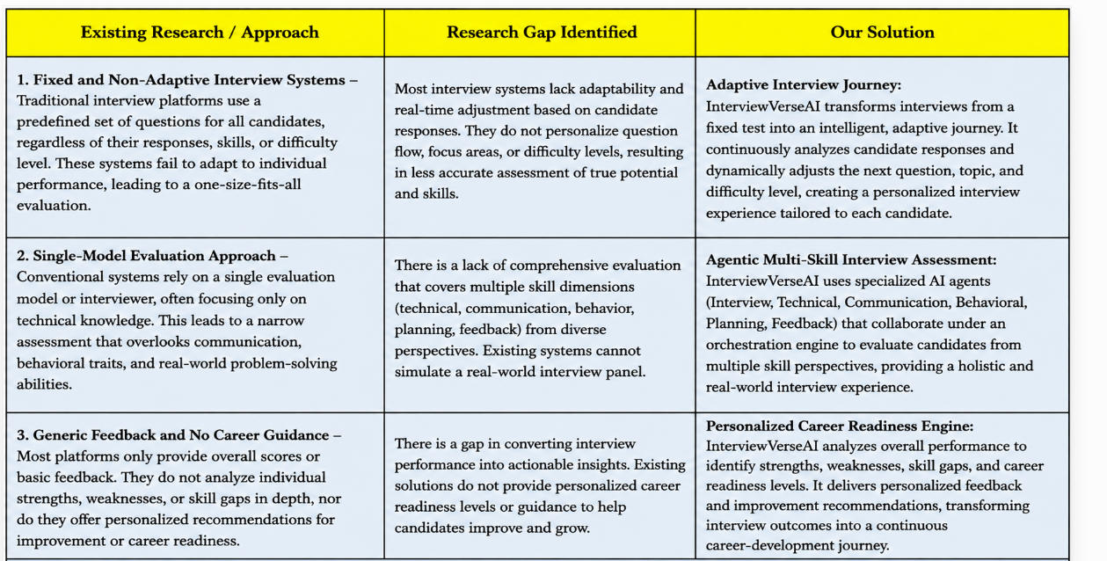
Research Gap

Slide 7
Novelty
1 - Adaptive Interview Journey
InterviewVerseAI transforms the traditional fixed interview into an intelligent, adaptive interview journey. Instead of presenting the same predefined questions to every candidate, the system continuously analyses the candidate's responses and dynamically adjusts the next question, topic, and difficulty level according to individual performance. This creates a personalized interview experience that evolves with the candidate.
2 - Agentic Multi-Skill Interview Assessment
Instead of relying on a single evaluation model, InterviewVerseAI employs specialized AI agents such as an Interview Agent, Technical Assessment Agent, Communication Agent, Behavioral Assessment Agent, and Feedback Agent. These agents collaborate under an Orchestration/Planning Agent to evaluate candidates from different perspectives and generate a comprehensive assessment covering technical knowledge, problem-solving, communication, and behavioural skills.
3 - Personalized Career Readiness Engine
InterviewVerseAI goes beyond conventional interview scoring by analysing the candidate's overall performance to identify strengths, weaknesses, skill gaps, and career-readiness levels. The system provides personalized feedback and improvement recommendations based on the candidate's assessment results, helping transform interview performance into a continuous career-development journey.
Overall Novelty
InterviewVerseAI transforms interviews from a fixed test into an intelligent, adaptive journey toward personalized career readiness.

Slide 8
Tech Stack
Layer | Technology Stack | Purpose in InterviewVerseAI
Frontend | React | Candidate interview interface, question display, response submission, and performance dashboard
Backend | FastAPI | Handles AI services, interview logic, APIs, and communication between frontend and AI modules
Backend / Enterprise Services | Spring Boot | Manages application services, candidate data, assessment workflows, and backend integration
AI / LLM | GPT-5 API | Generates adaptive questions, follow-up questions, evaluates responses, and produces personalized feedback
Speech AI | Whisper | Converts candidate voice responses into text for interview analysis
Agentic AI | LangChain | Orchestrates the interview agent, manages context, and controls the adaptive question flow
Database | PostgreSQL | Stores candidate profiles, interview questions, responses, scores, skill assessments, and feedback
Containerization | Docker | Packages and runs the frontend, backend, and AI services consistently

Slide 9
Innovation, Creativity
1. Agentic Interviewer
Existing: Fixed interviewer/question sequence.
Our Approach: AI agent dynamically decides what question should be asked next.
Benefit: Creates a personalized interview flow.
2. Adaptive Difficulty
Existing: Same difficulty for all candidates.
Our Approach: Difficulty changes according to candidate performance.
Benefit: Provides an appropriately challenging assessment.
3. Multi-Skill Evaluation
Existing: Technical tests are often separated from communication/behavioral evaluation.
Our Approach: Combines multiple skill dimensions.
Benefit: Provides a more comprehensive candidate profile.
4. Personalized Career Feedback
Existing: Assessment ends with a score.
Our Approach: Converts assessment results into personalized improvement recommendations.
Benefit: Helps candidates prepare for future interviews and career opportunities.

Slide 10
Feasibility
1. Technical Feasibility
The system is technically feasible using existing NLP, LLM, machine-learning, speech-to-text, and web technologies.
The adaptive agent can be implemented using existing AI/LLM frameworks, while candidate responses can be processed using NLP models.
2. Economic Feasibility
The prototype can be developed using:
Open-source AI/ML libraries
Public datasets
Open-source development frameworks
Existing pretrained models
This reduces development cost.
3. Operational Feasibility
The system provides a simple workflow: Candidate → Interview → AI Assessment → Feedback → Career Report
Candidates can interact with the system without requiring specialized technical knowledge.
4. Integration Feasibility
Different components can be integrated through APIs: Frontend ↔ Backend ↔ AI Models ↔ Database ↔ Dashboard
Overall Feasibility
The project is feasible because it uses existing AI technologies in a new integrated architecture. The major contribution is the combination of agentic interviewing, adaptive assessment, continuous feedback, and career-readiness analysis.

Slide 11
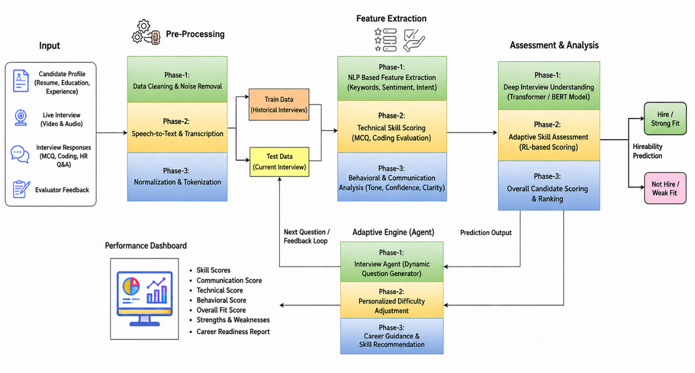
Project Architecture/Project Overview:

Slide 12
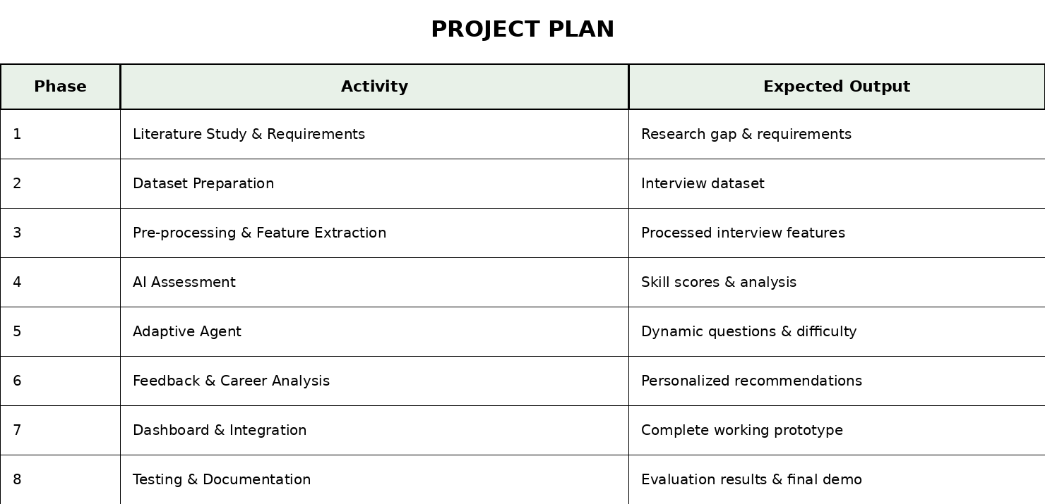
Project Plan

